Slide 1
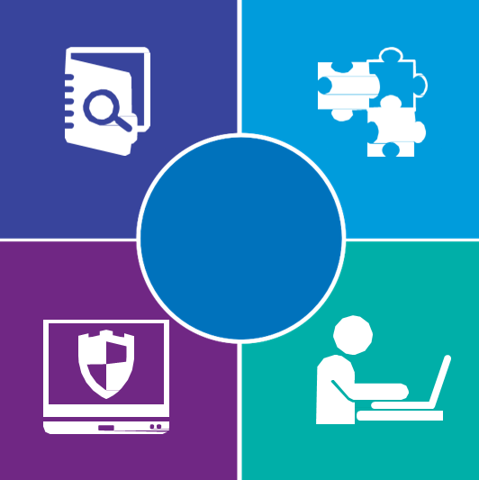
Technology and Cyber Risk Management
Protect and Enable Your Business with a Holistic Risk and Governance Framework
Cyber
Security Services

Slide 2
Cybersecurity Risk is the top CEO Concern
Yet most CEO’s are also aggressively pursing digital disruption with technology
Viewed as threats to growth.
Commonly related beliefs on risk.
33%
68%
Cybersecurity
Cyberattacks are a matter of when… not if
20%
81%
Emerging Technology
Technology is the only significant business disruptor
14%
91%
Operational Risk
Prepared to lead an operating model transformation, but don’t understand the data or risks

Slide 3
Dynamics are Changing
The operational landscape of today’s enterprise is moving faster than ever and IT can’t keep up….
Regulatory Pressures
Rapid Development
Evolving Workforce
Organizational Shifts
Performance drivers push business change faster that risk processes can react and regulatory requirements can be reviewed.
Accelerated development lifecycles increase the potential for the release of unmitigated risks across the enterprise.
Job shoppers and the need to close skills gaps pose risk in both consistent risk management and threats to intellectual property.
Large-scale organizational shifts are underway at top U.S. banks related to cyber risk and information security management.
Organizations need an effective operational risk management strategy to address dynamic technology and cyber risks and to better enable the business to make their own risk-based decisions.

Slide 4
The Drivers
The business wants to go faster and needs to be able to make their own risk-based decisions
Drivers of Change
Business Needs
Data sets are incomplete or stale
Data that is available, isn’t utilized
Action triggers aren’t defined or communicated
Actionable data with predictive risk management modeling
Data Sets Lack Utility
Organizational communication and decision making
Ineffective communications between business, technology, cyber risk
Model isn’t well defined resulting in inconsistent and ineffective results
Ineffective
Governance Structure
Business aligned strategy and governance
Unified objectives and outcome based, business impact reporting
Board reporting is often tactical and without defined objectives
The Board finds little value in communications from Cyber or Risk
Undefined Reporting
Objectives
Forward looking risk perspectives with clearly defined actions for the business

Slide 5
The Emerging Organizational Model
The new org model has the CISO in the first line reporting to the CIO, and a cyber security risk function reporting up to the Operational Risk Management Lead in the second line

Slide 6
Creating Better Metrics and Reporting
The cyber risk organization needs to create cyber risk appetite, KRI’s, and own the cyber policy

Slide 7
Three Lines of Defense Governance
The lines of defense come together in an operating model where Internal Audit provides its review and recommendations on a regular basis to help drive compliance and consistency
Business strategy
Business Growth Strategy & Objectives
Business Operations & Investments
Mergers & Acquisitions
Regulatory Interpretation & Guidance
Business Leadership
Organizational governance
Technology, Cyber, & Risk Management Strategy
Policy Governance & Management
Metrics & Reporting
Board Communications
3rd Line
Internal audit
Management Oversight and Governance
Policy and Standard Compliance
Controls Assurance
Technology & Cyber Risk Assurance
2nd Line
Independent risk management & reporting
Unified Assessment Framework
Policies & Standards
Risk Appetite, KRI’s, and Quantification
Collection, Assessment, Analysis, & Reporting
Technology and cyber risk strategy and planning
Program Strategy & Operations
Program Planning & Implementation
Policies & Standards
Monitoring & Analytics
1st Line
Technology and cyber risk operations
TCR Program Management
Controls & Control Implementation
IT Operational Management
Cyber Risk Operational Management
Process & Asset Inventories
Risks & Controls Management Program
Information Lifecycle
Data Governance
Resilience & Continuity
TCR Metrics & Measurement
Cyber Training & Awareness
Automation & Continuous Improvement

Slide 8
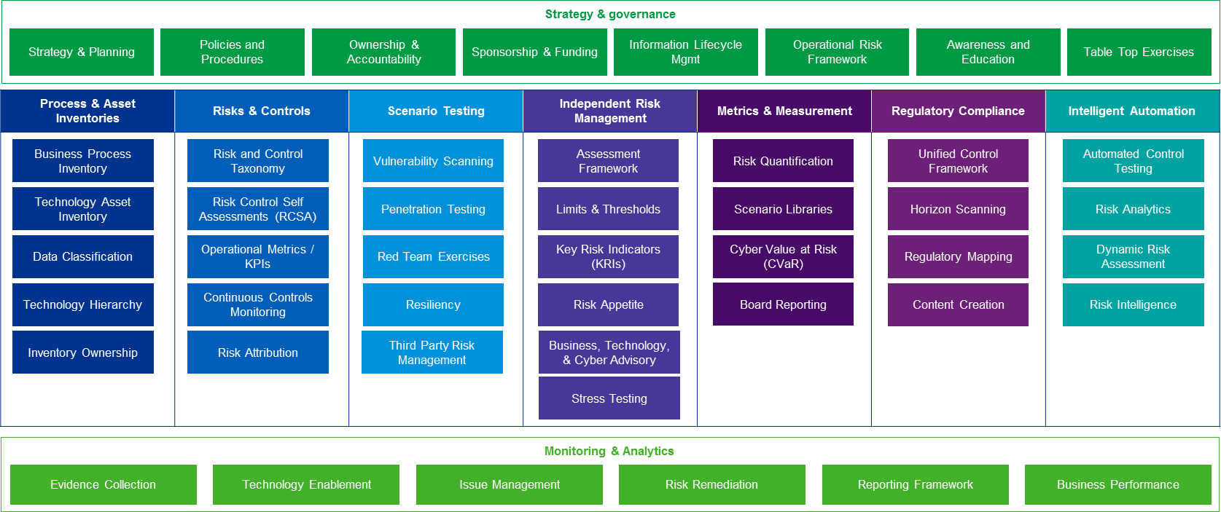
Leveraging a Framework
Understand what first line and second line functions are best suited for your organization

Slide 9
TCRM that Enables Your Business
Understand and adapt to the organization’s evolving risk profile to effectively manage information and technology risks and allocate the right investments
Leadership, support, and commitment are critical to successful implementation.
Board oversight is no longer just leading practice; it is expected by regulators.
Deploy a business driven and risk focused strategy, anchored to industry framework(s),
to provide comprehensive coverage of critical cyber security and technology risk activities.
Drive smart spending on targeted investments in high-risk areas to effectively managed
Cyber and technology risk aligned to critical business assets.
Find strategic balance between business performance and technology and cyber risk mitigation.
Establish three lines of defense in effective risk management and controls to foster a cohesive and coordinated approach for risk management and mitigation.
Clearly assign the responsibilities and accountability for technology and cyber risk management activities, and ensure that adequate skills are available to fulfill the assignments.

